Slide 1
Intro to
swift
Giorgio Natili @giorgionatili, Engineering Mentor and Technical Lead

Slide 2
Agenda
What’s New in XCODE 6
Swift Language
Key Concepts
iOS Auto Layout
User Interaction
Remote and Local Data
Core Data Basic
UITableView and Custom Cells

Slide 3
Takeaway
xcode
usage
swift
fundamentals
iOS
key concepts
Auto
layout
fetch
data
Data
persistence
app
layouts
app
architecture

Slide 4

Giorgio Natili
Technical Leader Agile Coach
Front-end Developer
Mobile Developer (PhoneGap, iOS, Android)
Technology Enthusiast
Open Source Fellow
Mentor @ Airpair.com

Slide 5

Mobile tea
http://www.meetup.com/mobiletea

Slide 6
intro to swift
Xcode 6.x

Slide 7
What’s new in xcode 6
features
Live rendering
Visual view debugging
Playground
Swift
Asynchronous code testing
iOS simulator

Slide 8
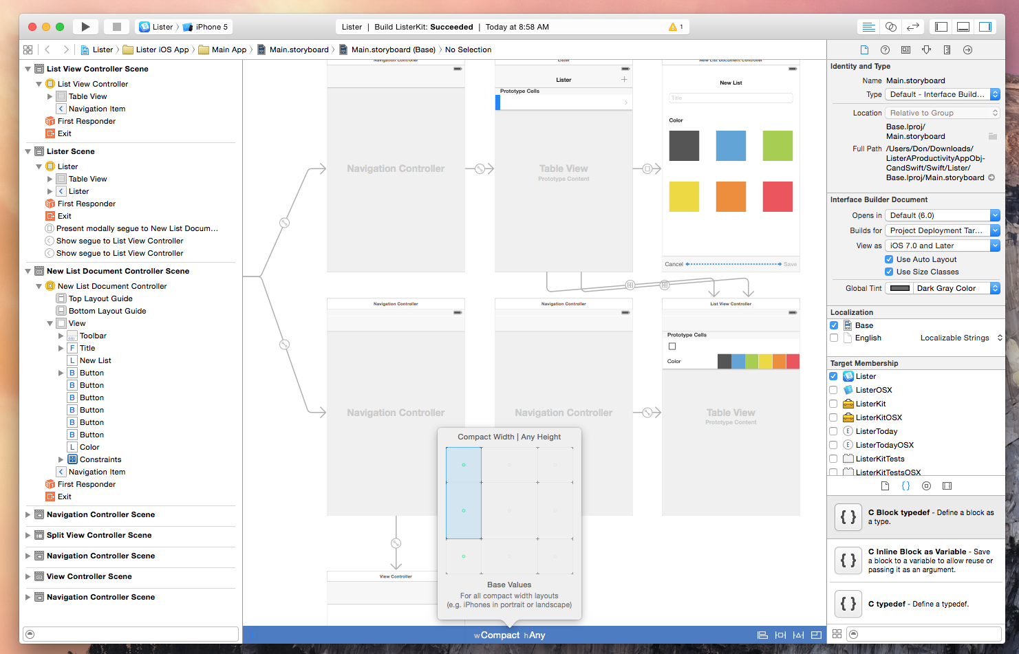
Visual design

Slide 9
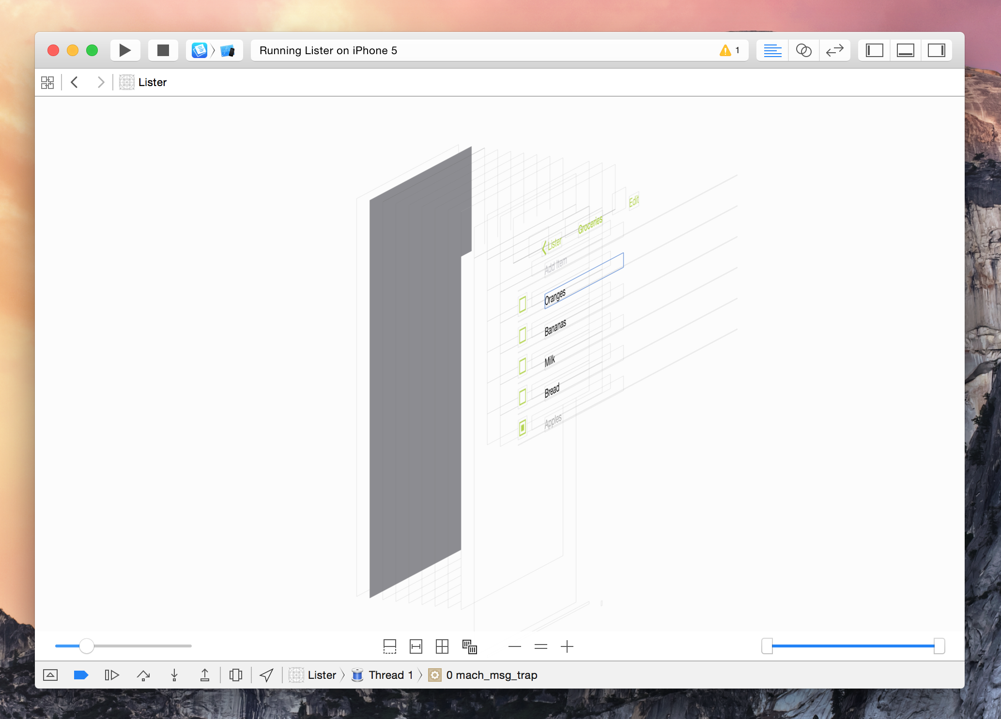
Live rendering

Slide 10
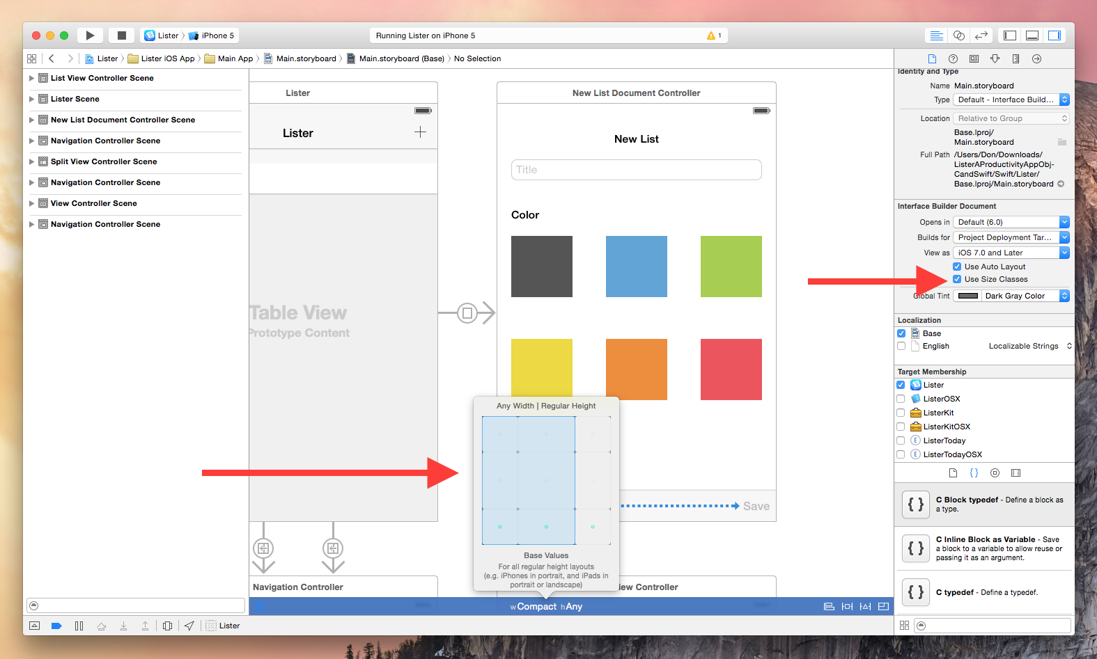
Multi screen design

Slide 11
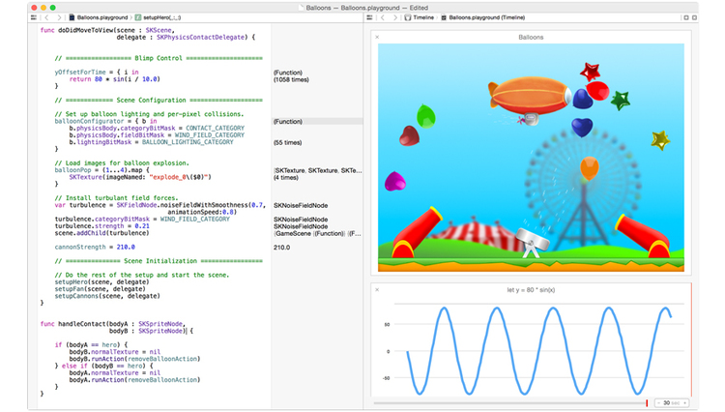
playground

Slide 12
Ios simulator
Improved SDK maintaining
More devices
Resizable devices

Slide 13
Asynchronous code testing
XCTest API enhancements
Network calls
File IO

Slide 14
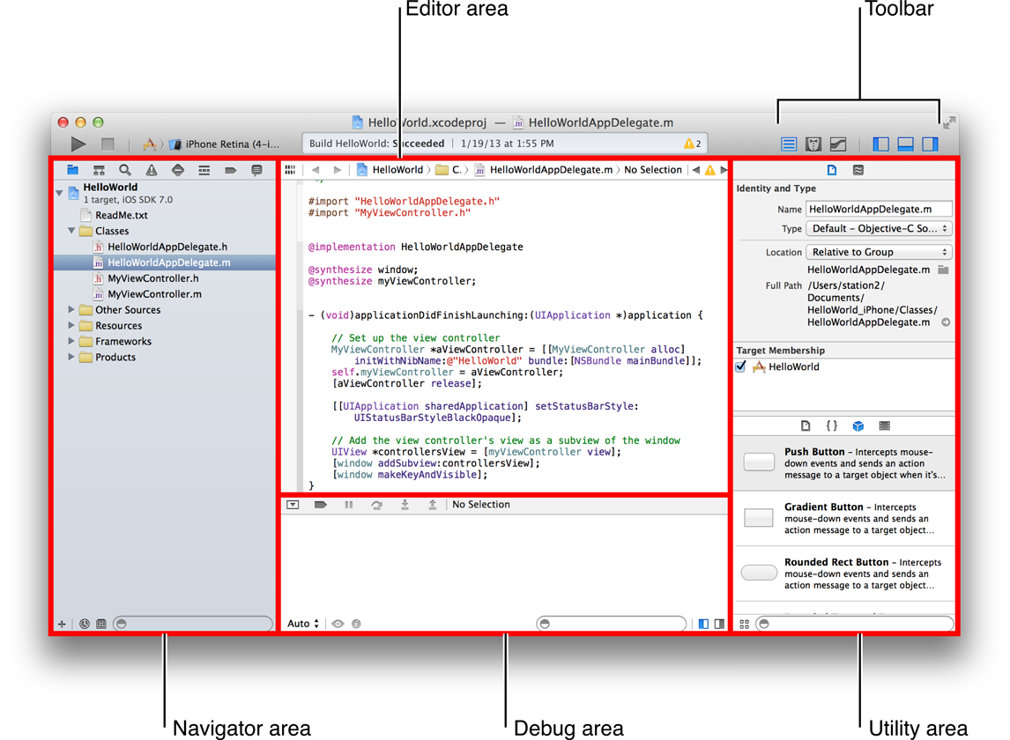
Xcode at a glance

Slide 15
Shortcuts – common keys
⌘ = Command
⇧ = Shift
⌥ = Option/Alt
⌃ = Control
⇠⇢ = Left/Right Arrow Keys
⇡⇣ = Up/Down Arrow Keys

Slide 16
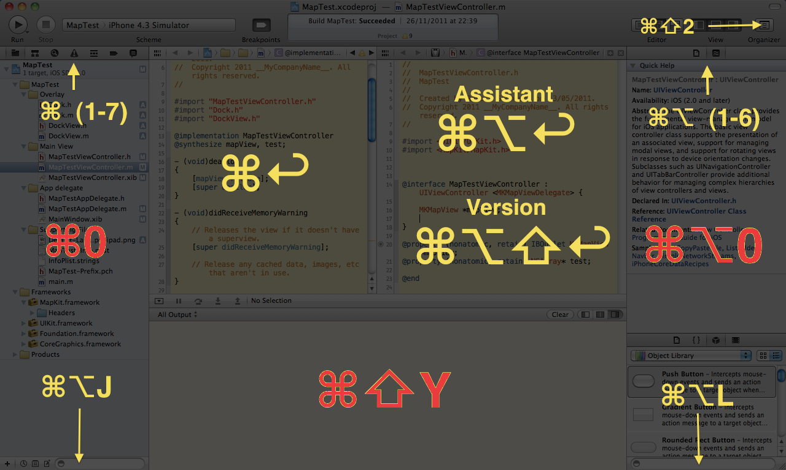
Workspace and shortcuts
http://www.rsaunders.co.uk/2011/11/xcode-shortcuts.html

Slide 17
Shortcuts – boost productivity
⇧ + ⌘ + O Open a file
⌃ + ⌘ + ⇡ OR ⇣ Switch between .m and .h files
⌘ + click on a variable/type Go to definition
⌃ + ⌘ + ⇠ OR ⇢ Go forward / Go back
⌃ + ⌘ + E Edit all in scope
⌘ + T Open a new tab
⌘ + W Close the current tab
⇧ + ⌘ + [ or ] Go forward / Go back in tabs

Slide 18
Shortcuts – Debugging
F6 Step over
F7 Step into
⌘ + \ Add/remove breakpoint
⌘ + Y Disable/enable all breakpoints
⌃ + ⌘ + Y Pause/Play the debugger

Slide 19
intro to swift
Swift basics

Slide 20
Data types – Basics
Char
Int
Float
Double

Slide 21
named and compound types
A named type can have a name assigned
Structures (e.g. Number and Strings), Classes, Enumeration, Protocols
A compound type has no name
Tuples and functions

Slide 22
Variables and constants
In Swift you can define a variable or a constant using different key words:
var
let
The general syntax to specify the type of the value stored in the var/const is:
var/let identifier: <Type>

Slide 23
Type inference
The variable or constant types are defined from the compiler
var i:Int = 10 is the same of var i = 10

Slide 24
Arithmetic expressions
Most of the commons defined in other modern languages: +, -, /, =, %, +=, -=, *=, %=
Pre and post increment/decrement operators: ++x, x++, --x, x--
var x = 0
var y = x++
var y = ++x

Slide 25
Boolean expressions
Relational operations as in other modern languages: ==, <, >, <=, =>, !=
Ternary operator: ?
[condition] ? [execute if true] : [execute if false]

Slide 26
Conditional statements
if <condition>{
}
switch value {
case something:
case somethingElse:
default:
}

Slide 27
Control transfer statements
return: stops the execution and return a value
falltrough, force a C style behavior and all the cases are evaluated
continue, tells a loop to stop what it is doing and start again at the beginning of the next iteration
break, ends execution of an entire control flow statement immediately

Slide 28
loops
Supports the most common loops: for, while, do…while, etc. but has couple of nice hints for ranges and parameters:
for i in 0…9{
println("i = \(i) ”)
}
for _ in 0..<10{
println("I don’t care about i")
}

Slide 29
Collection types – array
An array stores an ordered list of values of the same type
There is no more disitinction between NSArray and NSMutableArray
An array can be instantiated using the literal syntax or the array type syntax
var languages: [String] = ["swift", "objc"]
is the same of
var languages = ["swift", "objc"]

Slide 30
Collection types – array methods
count
isEmpty
append
insert(that, atIndex:)
removeAtIndex(index)

Slide 31
Collection types – dictionary
A dictionary it’s a collection that stores key-value pairs with all the keys having the same type and all values having the same type as well.
var states = ["NY": "New York", "MA": "Massachuset"]
count
isEmpty
updateValue(val, forKey:)
removeValueForKey

Slide 32
Functions
func is followed by the identifier
identifier, is followed by a parameter list enclosed in parentheses
->, optionally specifies the return type of the function
func sayHello(name:String)->String{
return "Hello " + name
}

Slide 33
Functions – constant and variable parameters
By default functions parameters are constant
Optionally can be declared as variables var
func hello(var message:String, name:String)->String{
message += name
return message
}

Slide 34
Functions – inout parameters
When a function is used to modify an existing value it’s possible to pass it as an inout parameter
var value
func updateValue(inout data:T){
// Do something
}
updateArray(&value)

Slide 35

Lab 1
Calculate the average number in Swift-playground using a function.

Slide 36
closures
Closures are expressions that resemble “anonymous” or unnamed functions; a closure is a self-contained blocks of functionality that can be passed around in your code.
let helloFromClosure = {(name:String) -> String in
return "Hello " + name + " from your closure! "
}

Slide 37
Closures + array
Ordering an Array with a closure make the code more compact and easy to read
let var animals = ["Dog", "Cat", "Fish", "Worm"]
let sortedStrings = animals.sorted(
{(one:String, two:String) -> Bool in
return one < two
})

Slide 38

Lab 2
Find the sum of all even numbers between 1 and 10 contained in an Array.

Slide 39
classes
The syntax is similar to the one of the most common languages
A class can contains method and stored or computed properties
class Person{
var name:String = "Giorgio"
var computedName:String {
get { return name + " " + rand().description}
}
}

Slide 40
Classes – initializers
Each class must have an initializer
Strictly speaking the initializer is where the class member will be initialized (partially not true)
An initializer accept parameters like a function
A class can have multiple initializers that differ in their signature

Slide 41
Classes – initializers
class Animal{
init(){ // Some code }
}
class Animal{
init(specie:String){
println("I am a \(specie)")
}
init(specie:String, gender:String){
println("I am a \(specie), my gender is \(gender)")
}
}

Slide 42
Classes – members signature
By default all the members have an internal access level
Other optional access levels are public, private, final and static
The access level of a custom type affect all the members of that type
The internal level
It means internal to a product, a product is an app or a framework or any other distributable compiled item.

Slide 43
protocols
A protocol is a specification that list the properties and methods an implementer has to support
A property is specified declaring a variable followed with a type and then either {get} or {get set}
A method is specified using the func keyword followed by the function signature
protocol DailyGreting{
var userName:String {get set}
func welcome() -> String
}

Slide 44
Lab 3
Imagine to work in the finance industry and define a protocol to ensure that all the type of bank account are able to print out the full name of the owner, the balance and the account id. Define also a couple of account types using classes.

Slide 45
structures
A struct is a complex data type declaration that defines a physically grouped list of variables to be placed under one name in a block of memory. (wikipedia)
struct are value types ,it means if you copy the instance of the structure to another variable it just copied to the variable
class are reference type ,it means if you assign a instance of the class to another variable, it will hold only the reference of the instance not copy

Slide 46
Structures – mutating methods
A struct can have properties, methods, initializers and can be extended; a method that changes the value of a property is marked as mutating
struct Account{
var accountId:Int
var amount:UInt8 = 0
init(id:Int){
accountId = id
}
mutating func manageAmount(value:UInt8){ amount += value}
}

Slide 47
enumerations
An enumeration is a common type for encapsulating a group of related values which can be accessed in a type-safe way within the code
enum AccountType{
case Savings
case Checking }

Slide 48
Enumerations – with data types
enum AccountType:String{
case Savings = "savings"
case Checking = "checking"
}
enum AccountID{
case inString (String)
case inNumber (Int)
}

Slide 49
Swift optionals
Using optionals it’s possible to assign a nil value to a variable
An optional is defined using the ? sign
var age:Int? = nil
Optional is an enumeration defined in Swift, an optional can also be empty
enum Optional : NilLiteralConvertible {
case None
case Some(T)
}

Slide 50
Swift optionals – unwrapping
An optional value needs to be unwrapped before using it, you can force the unwrap with the ! Sign
It’s safer to unwrap an optional using a kind of bind technique
if let value = possibleValue { // Something happens }

Slide 51
Func optional return values
It’s possible that a function doesn’t return a value, an optional can be used also in the function return type
func maxValue(nums: [Int]) -> Int?{
return nums.reduce(Int.min, { max($0, $1) })
}

Slide 52
tuples
Tuples enable you to create and pass around groupings of values
let http404Error = (404, "Not Found")
// http404Error.0 or http404Error.1

Slide 53
Lab 4
Implement a function able to return a tuple containing the max, the min and the average value of a sequence of numbers contained into an Array.

Slide 54

Lunch time

Slide 55
intro to swift
Hello world!

Slide 56
Hello world app
Open XCODE
Create a single view app
Drag a button to the main view in the storyboard
Right click on the button and create a binding for the touch up inside event
Open an alert from the event handler
let alertController = UIAlertController(title: "Welcome to My First App", message: "Hello World", preferredStyle: UIAlertControllerStyle.Alert)
alertController.addAction(UIAlertAction(title: "OK", style: UIAlertActionStyle.Default, handler: nil))
self.presentViewController(alertController, animated: true, completion: nil)

Slide 57

What’s happened?

Slide 58
Basic concepts
The user interface in storyboard is the interface, while the code is the implementation
The user interface elements (e.g. button) communicate with the code via messages
The @IBAction keyword allows to connect your source code to user interface objects in Interface Builder

Slide 59
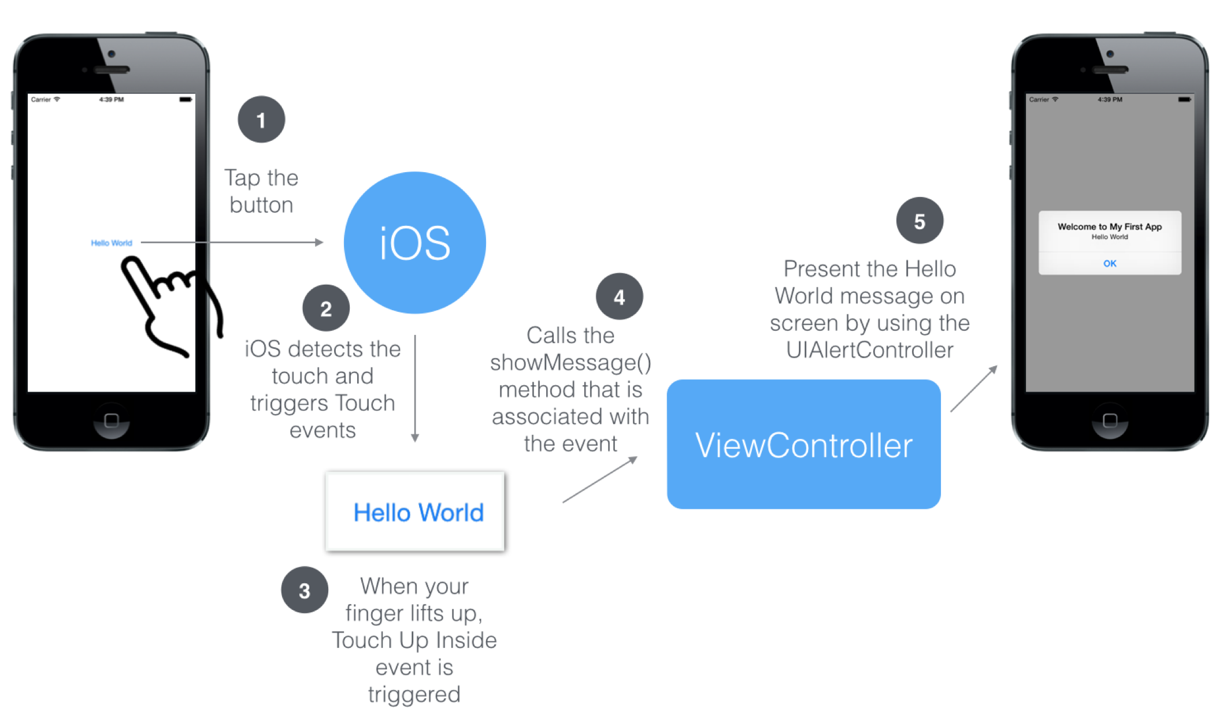
Under the hood

Slide 60
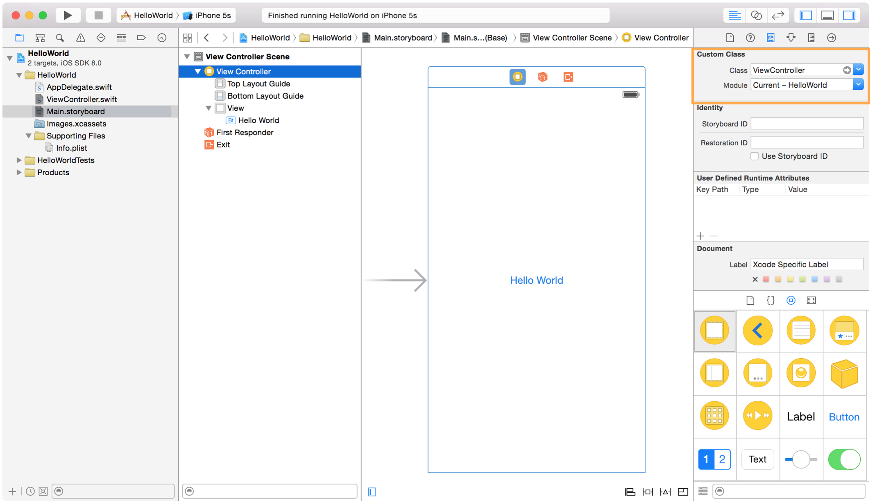
ui and view controllers

Slide 61
Owner, responder and exit
The File Owner is an instantiated, runtime object that owns the contents of your .xib and its outlets/actions when the .xib is loaded
The First Responder is simply the first object in the responder chain that can respond to events
The Exit is the method to be executed when .xib or the View Controller are unloaded from the view

Slide 62
Lab 5
Create the Hello World application and add another View Controller to the storyboard; the view controller should be rendered when a button is touched and should render some text.

Slide 63
intro to swift
Auto layout

Slide 64





Different platforms but same layout issues

Slide 65
ui design, retina and 3x
In the storyboard or in a .xib file the UI element are positioned using a point based coordinate system
Until retina display a point was the equivalent of a pixel
With retina displays resolution doubled and a point corresponds to two pixels
iPhone 6 Plus introduced another complication, a point now corresponds to three pixels

Slide 66
Auto layout
Auto Layout is a constraint-based layout system
It allows developers to create an adaptive UI that responds appropriately to changes in screen size and device orientation
In XCODE 6.1 allows to have a live preview in the storyboard itself

Slide 67
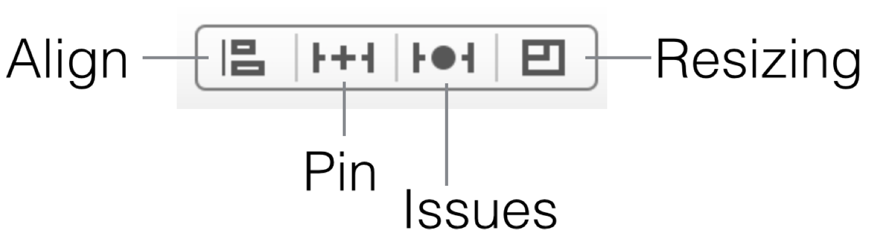
Defining constraints
Align, create alignment constraints, such as aligning the left edges of two views
Pin, create spacing constraints, such as defining the width of a UI control
Issues, resolve layout issues
Resizing , specify how resizing affects constraints

Slide 68
Lab 6
Open again the Hello World app and using Auto Layout make the UI elements rendering properly on the iPhone 4s, iPhone 5s and iPhone 6 Simulators.

Slide 69
intro to swift
Table view

Slide 70
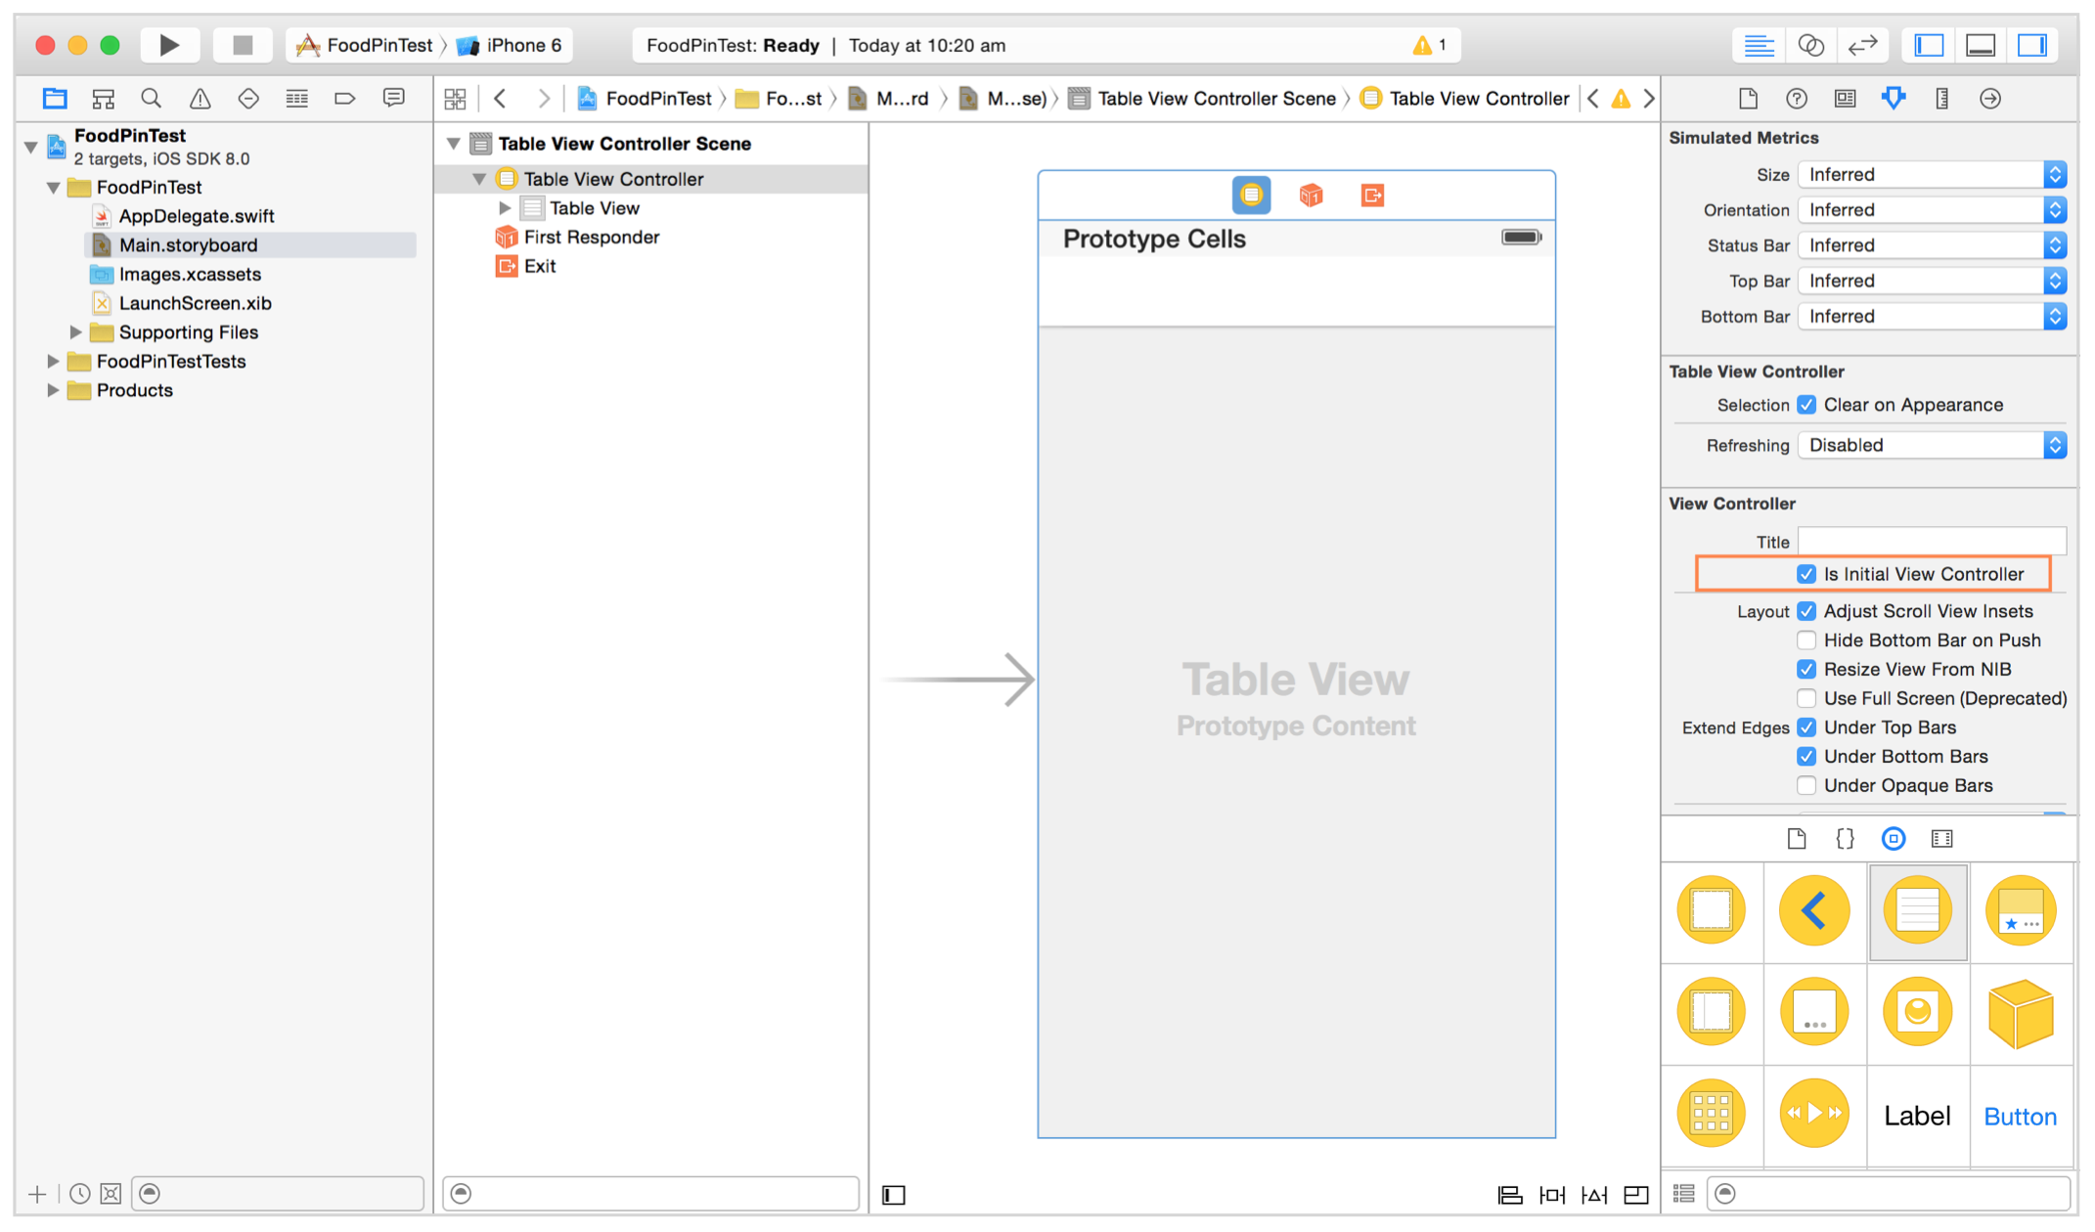
Table view layout

Slide 71

table view apps

Slide 72
intro to swift
Fetch + Persist data

Slide 73
Remote data – json
NSURL, represents a URL that can potentially contain the location of a resource on a remote server
NSURLSession, provide an API for downloading content via HTTP
NSURLSession.dataTaskWithURL,creates an HTTP GET request for the specified URL
NSJSONSerialization,convert JSON to Foundation objects and viceversa
XCPSetExecutionShouldContinueIndefinitely
It forces the playground to keep continuing executing the code after the end of the code block.

Slide 74

Lab 7
Using the NSURL, NSURLSession and NSJSONSerialization APIs load a remote JSON file and display the contents of its properties in multiple labels.

Slide 75
core data
Data holding in memory (e.g. array) is volatile
To save the data permanently a persistent storage like file or database is required
Core Data is not a database also considering that SQLite database is the default persistent store for Core Data on iOS

Slide 76
core data – the stack
Managed Object Context, it is a temporary memory area containing objects that interacts with data in persistent store. Its job is to manage objects created and returned using Core Data framework
Persistent Store Coordinator, SQLite is the default persistent store in iOS
Managed Object Model, it describes the schema that you use in the app (kinda of database schema)
Persistent Store, it is the repository that your data is actually stored (a SQLite database or a binary or XML file)

Slide 77

Exploring core data

Slide 78
intro to swift
Q&a

Slide 79

We have done!

Slide 80
thanks!
Giorgio Natili
Body Level One
Body Level Two
Body Level Three
Body Level Four
Body Level Five
Body Level One
Body Level Two
Body Level Three
Body Level Four
Body Level Five
Optional Information:
E-mail: me@webplatform.io
Source: github.com/giorgionatili/swift (since tomorrow!)
Twitter: @giorgionatili

